Slide 1
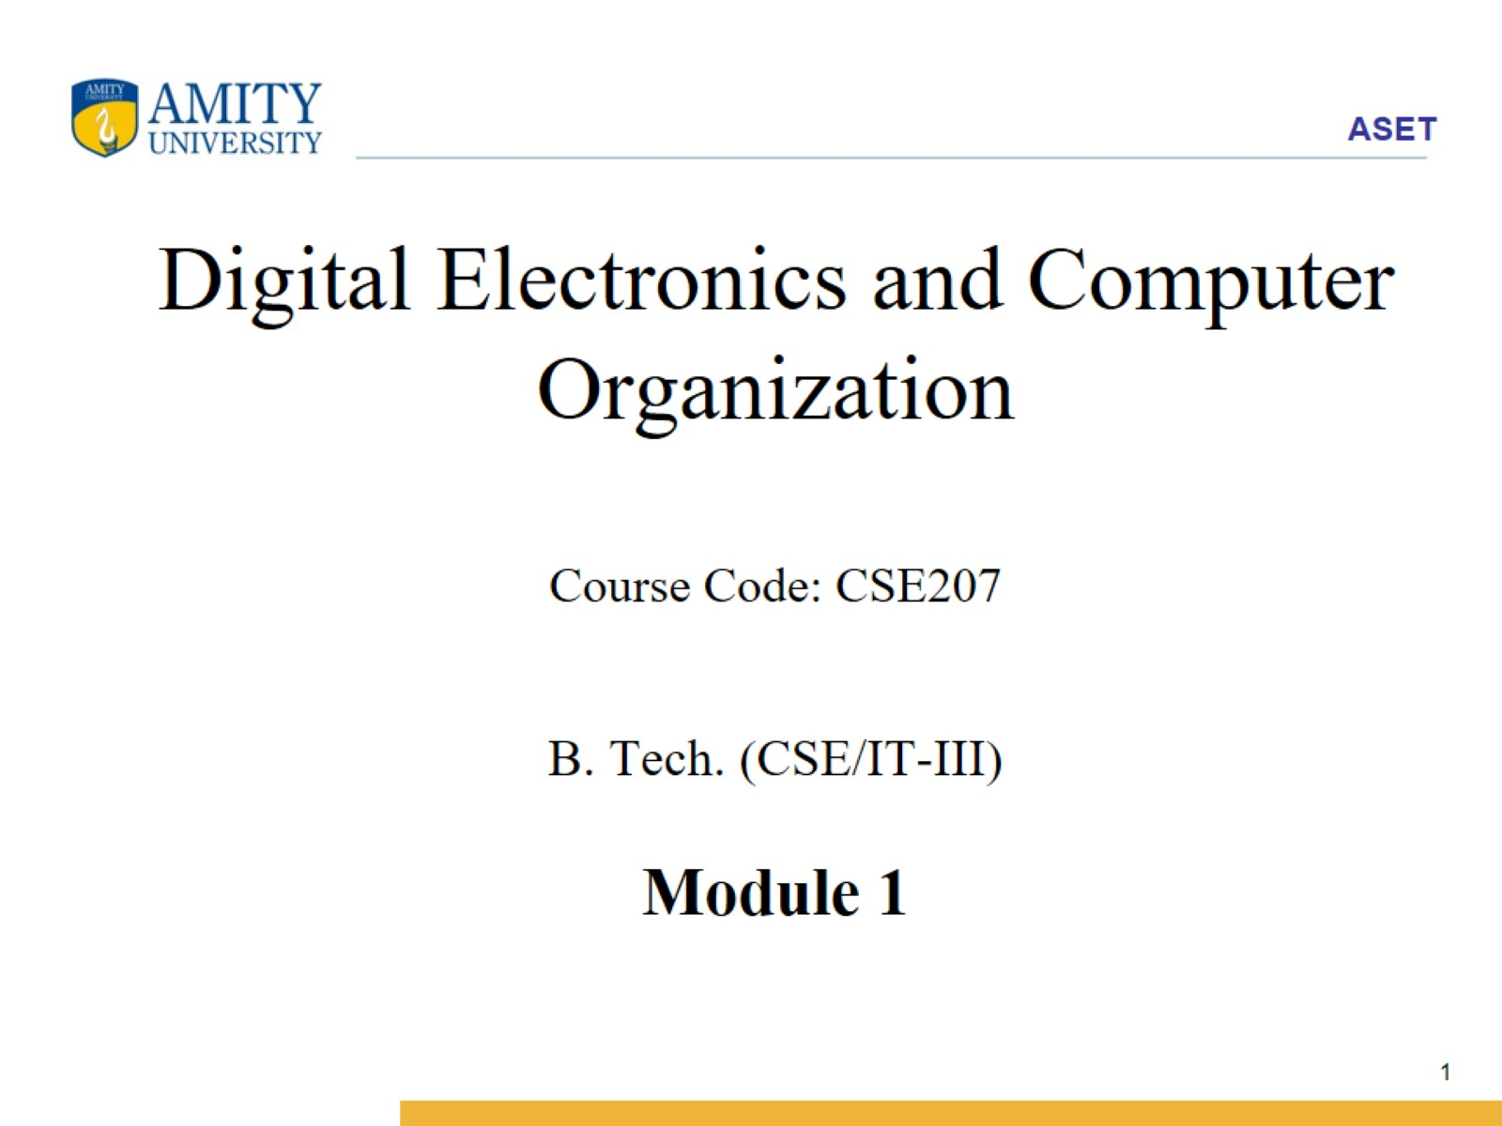
Digital Electronics and Computer Organization Course Code: CSE207 B. Tech. (CSE/IT-III) Module 1

Slide 2
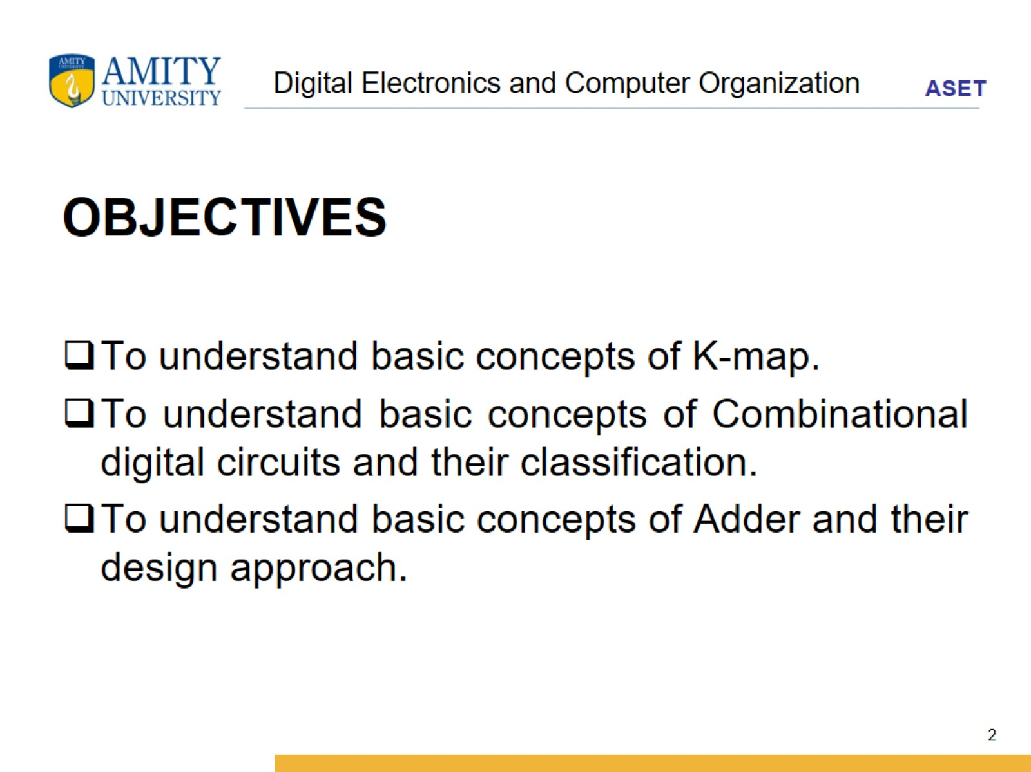
Digital Electronics and Computer Organization

Slide 3
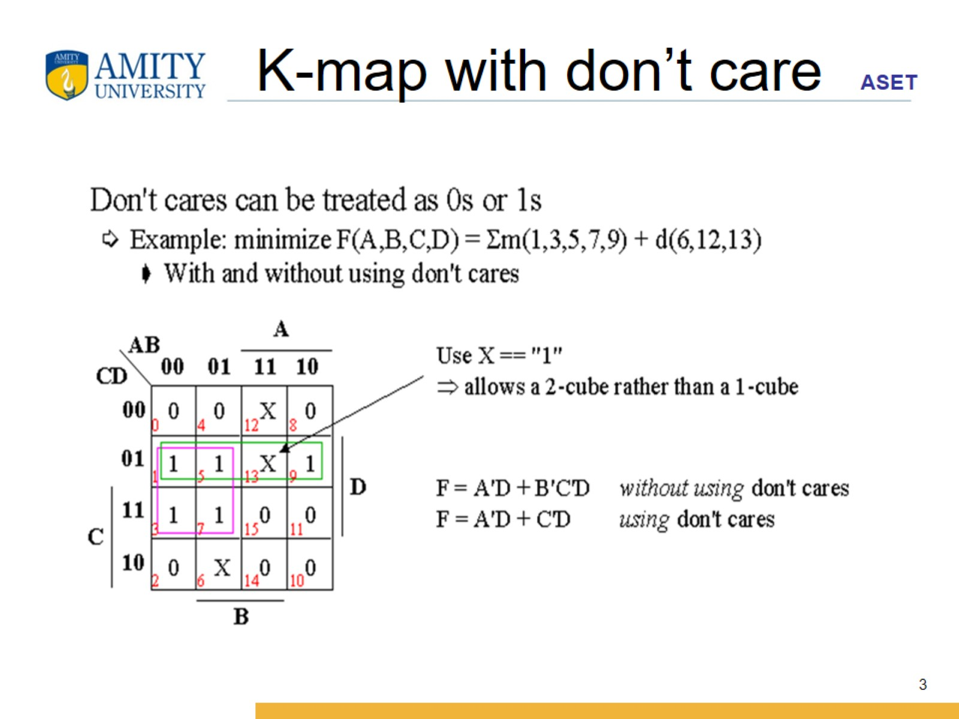
K-map with don’t care

Slide 4
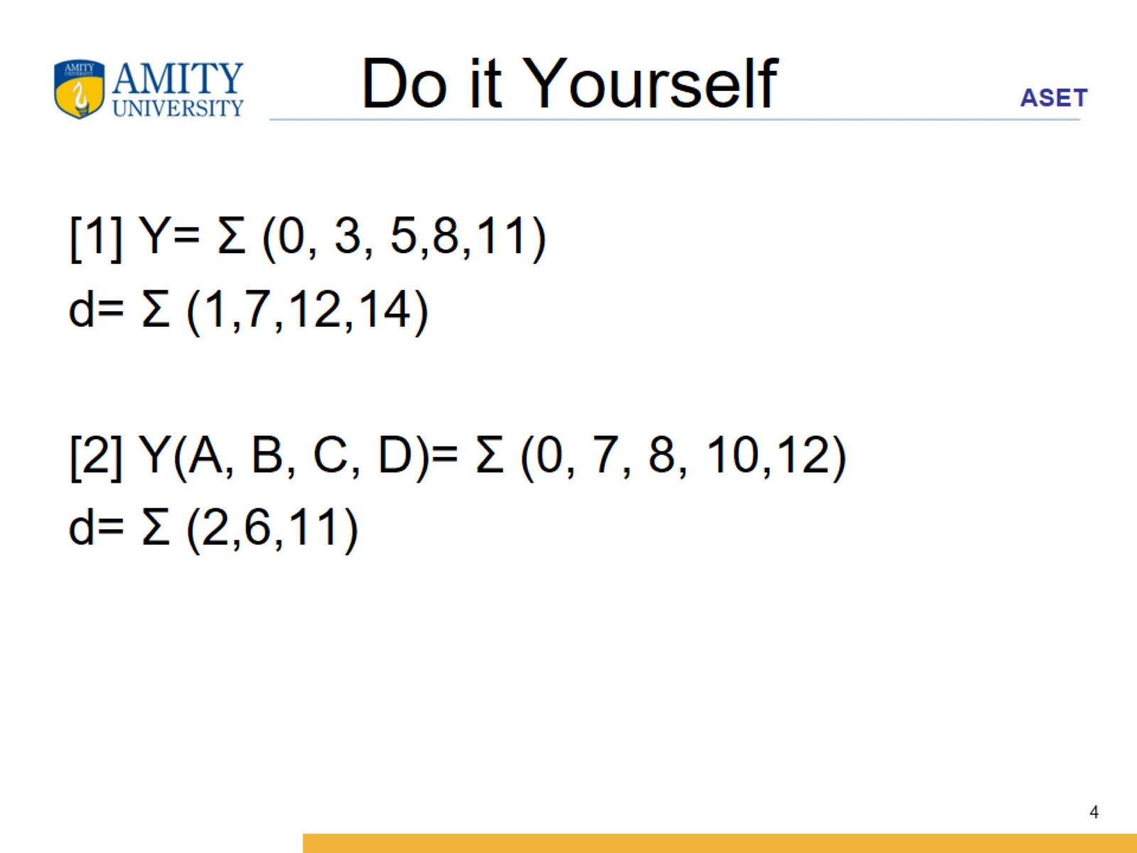
Do it Yourself

